Slide 1
Enhanced Photometric Stereo with Multispectral Images
[11 – 4] International Conference on Machine Vision Applications 2013
Tsuyoshi Takatani† Yasuyuki Matsushita‡ Stephen Lin‡
Yasuhiro Mukaigawa† Yasushi Yagi†
† Osaka University ‡ Microsoft Research Asia

Slide 2
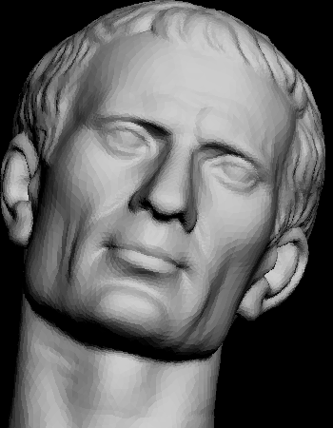
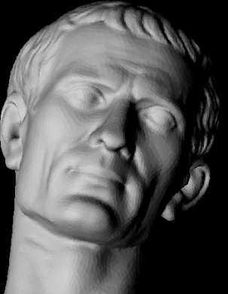
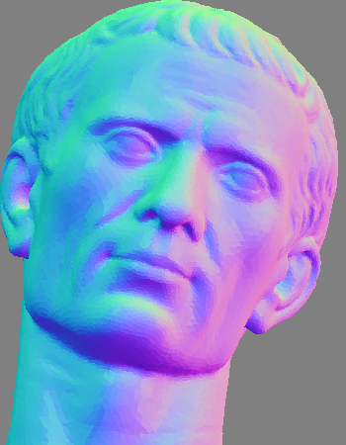
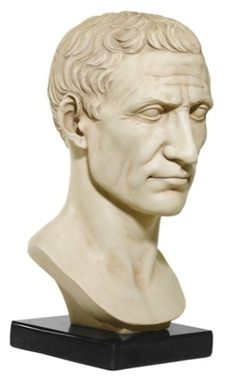










Introduction
Photometric stereo
  Based on Lambert’s cosine law
$$I(x)=ρ(x){n(x)}^{T}l$$
Observed intensity
Albedo
Normal vector
Light direction
Light $l_{2}$
Light $l_{1}$
Normal map
$$I_{1}=Nl_{1}$$
$$I_{2}=Nl_{2}$$
$$I_{3}=Nl_{3}$$
$$I=NL$$
$$N=IL^{+}$$
Light $l_{3}$
Camera

Slide 3
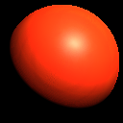
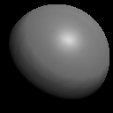

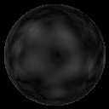
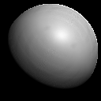

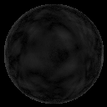
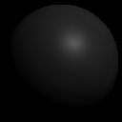

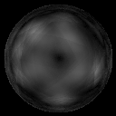


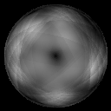
Question
How to get the intensity?
Normal map
Error map
Avg. angular error (var.)
2.56 (2.63)
Color
Gray
Accuracy varies with wavelength
Red plastic
from MERL BRDF
1.42 (1.02)
Red
Gnd. truth
5.37 (11.42)
Green
13.43 (44.13)
Blue

Slide 4
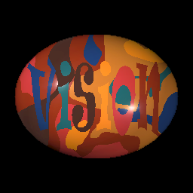
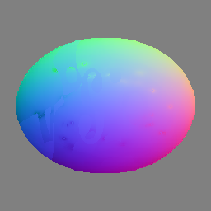
Purpose
Improve the accuracy of photometric stereo using multispectral information
  Lambertian photometric stereo
Wavelength 1
Wavelength 2
Photometric stereo
with different wavelengths
Merge
Wavelength 3

Slide 5
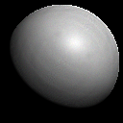
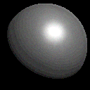
Causes why accuracy varies with wavelength
Noise
  Signal to noise ratio (SNR) changes w.r.t. a surface color
Subsurface scattering
  Degree of penetration changes w.r.t. wavelength of the light
Low SNR
Red object
R channel
B channel
Blue light
Red light

Slide 6
How to obtain a better result
The effect of noise and subsurface scattering
Obtain a better result
  Small effect of noise and subsurface scattering
  → More consistent with Lambert model
Noise
Subsurface scattering
Observation: Not consistent with Lambert model
How close the observation is to Lambert model

Slide 7


Key idea: Check of consistency with Lambert model
Rank of observation matrix
$$I=NL$$
$$\text{rank}\left(I\right)=3$$
  Contribution ratio of the eigenvalues by PCA
 | Perfect Lambert model | With noise and subsurface scattering
1 | 59.81 % | 67.47 %
2 | 21.86 % | 16.26 %
3 | 18.30 % | 4.59 %
4 | 0.01 % | 3.32 %
5 | 0.01 % | 1.38 %
Total | 99.99 % | 93.02 %
Rank of observation matrix
→ Key of consistency with Lambert model

Slide 8
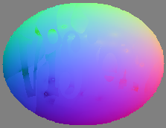
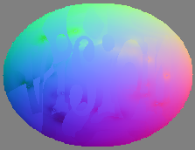
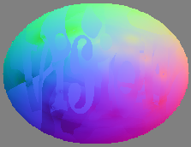
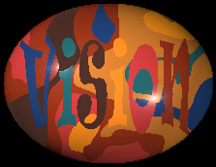
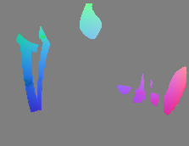
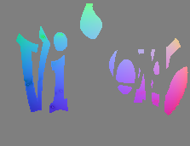




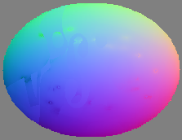

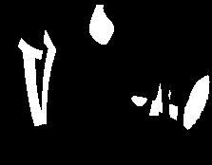



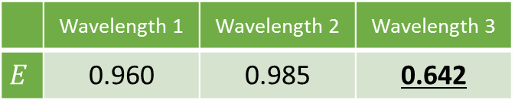


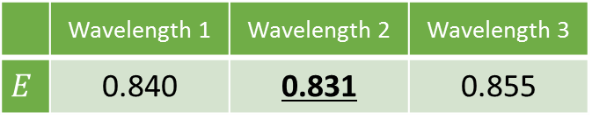


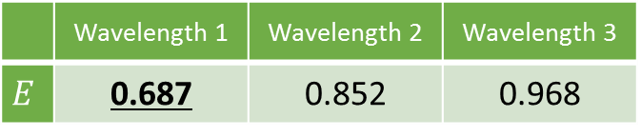






Identification of optimal wavelength
Evaluation based on matrix rank analysis
Flow
$$E→0$$
$$\text{rank}\left(I\right)=3$$
  $$σ_{4}=0$$
$$E=\frac{σ_{4}}{σ_{3}}$$
$$\text{rank}\left(I\right)>3$$
  $$σ_{4}>0$$
$$\text{rank}\left(I\right)<3$$
  $$σ_{3}→0$$
$$\text{rank}\left(I\right)→3$$
($σ_{i}$: $i$-th eigenvalue of $I$)
Compute a normal map at each wavelength
Observe
Merge normal maps
at optimal wavelengths
Wavelength 1
Wavelength 2
Wavelength 3
Segmentation
 | Wavelength 1 | Wavelength 2 | Wavelength 3
$$E$$ | 0.960 | 0.985 | 0.642
 | Wavelength 1 | Wavelength 2 | Wavelength 3
$$E$$ | 0.840 | 0.831 | 0.855
 | Wavelength 1 | Wavelength 2 | Wavelength 3
$$E$$ | 0.687 | 0.852 | 0.968
Optimal wavelength when $E$ is minimum

Slide 9
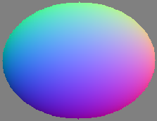
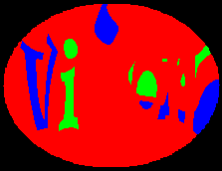
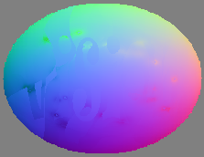
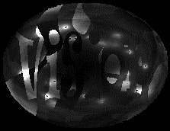
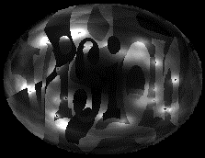
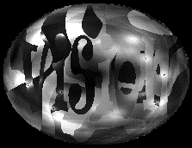
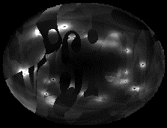
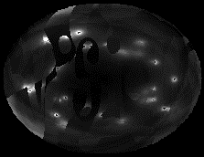
Experiment on simulation images
Rendered forty images of an egg-shaped object
  MERL BRDF: Blue-acrylic, Green-plastic, Light-brown-fabric, Orange-paint, Purple-paint, Red-phenolic, Yellow-matte-plastic
Rendered image
Ground truth
Segmentation
Optimal wavelengths
Red channel
Green channel
Blue channel
Grayscale
Ours
Normal map
Angular error
(Avg. / Var. [deg])
4.16 / 0.49
5.88 / 0.73
10.40 / 1.51
4.29 / 0.37
3.14 / 0.16

Slide 10


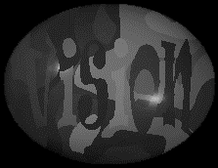

Discussion for experiment on simulation images
The effect of noise
The effect except SNR
Ours
Red channel
3.14 / 0.16
Grayscale
In some regions, the result by each channel images has less error
4.29 / 0.37
Channel | Angular error | Evaluation value
Red | 2.17 | 0.767
Green | 3.03 | 0.812
Blue | 12.02 | 0.897
Optimal wavelength
R
G
B
Orange-paint region
Brightness

Slide 11
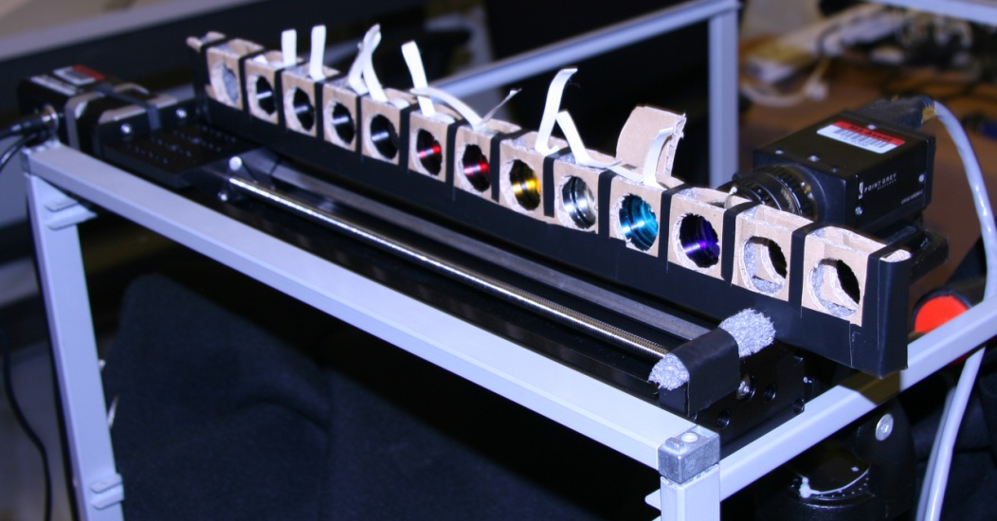
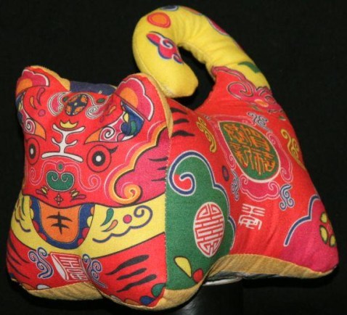
Experiment on real images
Setup
  Nine wavelengths (450, 488, 580, 650, 694, 730, 780, 880, 940[nm)
  Recorded under 12 different lighting directions
  Target: Plushie
    made of fabric of different colors
Camera
Translation stage
to change the filters

Slide 12
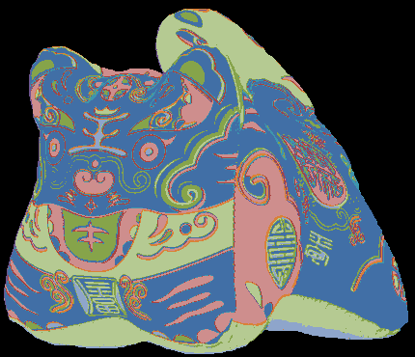
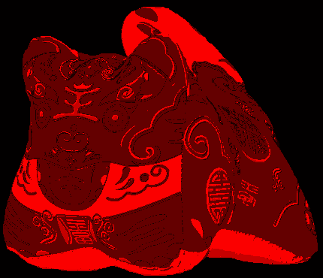
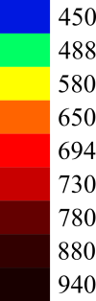
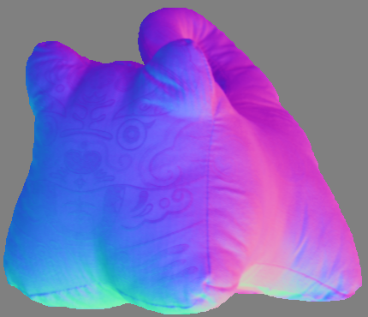
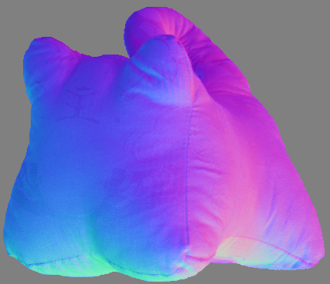
Result by our method
Target object (plushie)
Segmentation (9 segments)
Optimal wavelengths
Removed texture
Grayscale
Ours

Slide 13
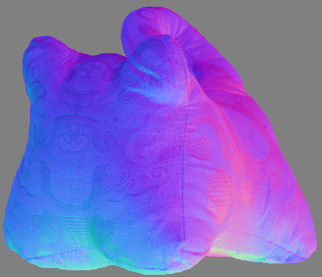
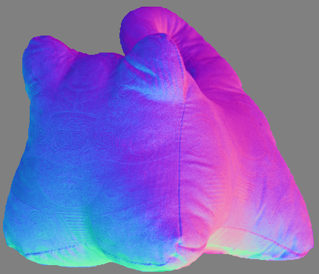
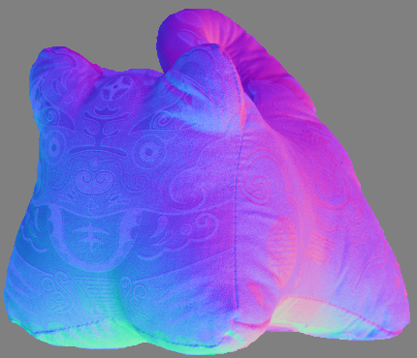
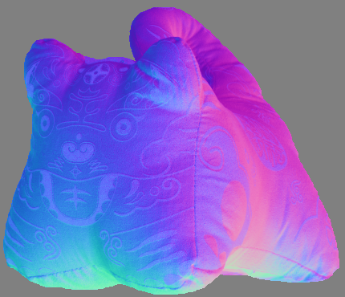
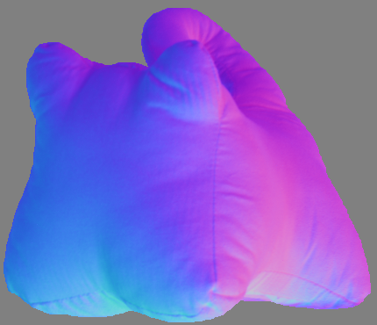
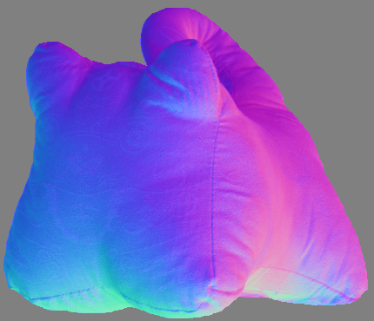



Results by different wavelengths
450nm
488nm
580nm
650nm
694nm
730nm
780nm
880nm
940nm
Grayscale
Ours

Slide 14
Conclusion
Enhanced Lambertian photometric stereo with multispectral images
Experiments on simulation and real images
  Better than using grayscale images
  Available even with RGB images
[Future work]
  Extend for other parametric reflectance models
  Estimate the ideal rank of observation matrix
    Ideal rank from grayscale images
  Improve the way to identify the optimal wavelength
    Chose one observation → Remove bad observations
Grayscale
Ours

Slide 15


Thank you for your listening
Observe
Compute a normal map at each wavelength
Merge normal maps
at optimal wavelengths
Wavelength 1
Wavelength 2
Wavelength 3
Segmentation
$$E=\frac{σ_{4}}{σ_{3}}$$
Optimal wavelength
when $E$ is minimum
Experiment on simulation images
Experiment on real images
Grayscale
Ours
Grayscale
4.29 / 0.37
Ours
3.14 / 0.16

Slide 16
Light source
Halogen bulb

